Slide 1
Development of Augmented reality viewer
BY:
A. Arathy
3rd cse –B
920418104011

Slide 2

CONTENTS
Problem Statement
Introduction
Objective
Literature Survey
Methodology
Requirement Specification
System Design
Implementation
Results
Social impact
References

Slide 3

Problem Statement
Now a days with the advancement of technology, people can have a real time experience of virtual things.
This project presents a basic AR projector; a hardware component useful to view AR based applications in mobile and websites. The main aim of this project is to aid the students with real time experience to learn the concepts with the help of a cheaper, but quality AR viewer.

Slide 4
introduction
As emerging technology, Augmented Reality (AR) brings up a lot of advantages to technologies such as information display, image processing, fast computing and networking. In this project, an AR viewer is build to be used in the Education Sector.

Slide 5
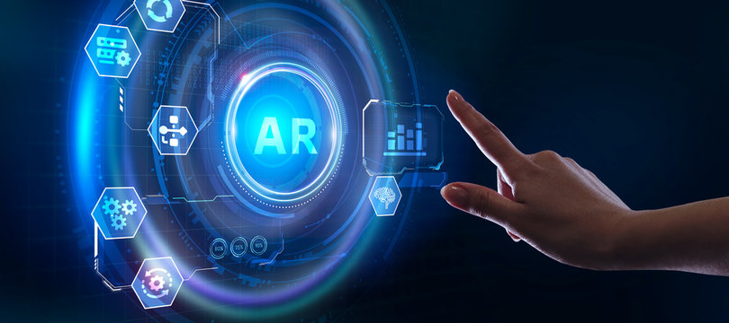
Objective
The objective of the project is to view the object in 2d(or 3d) with the real world to experience the 360 degree view of the object.
To implement a relatively small setup which can fit into a both physical world and virtual world.

Slide 6
Literature Survey
Presently, many organizations are exploring the advantages that applications of augmented reality have to offer. Literature reviews indicate state of the art research being done at the following organizations:
University of North Carolina (develop and operate a system that allows a physician to see directly inside a patient, using AR).
Columbia University (developing a prototype system that uses a see through head-mounted display to explain simple end-user maintenance)

Slide 7
Literature Survey
Boeing (development of a system for assembly procedures)
Siemens (development of systems for control of complex systems and processes)
Naval Research Lab (develop and operate a battlefield information transfer system)
University of Washington (develop an augmented reality authoring program)

Slide 8
Methodology:
We see objects in our world by the light reflected from them.
Our mind creates a projection of object in the line of incoming light.
To mix a virtual object into our real world, we need to find a way to project it such that it creates a kind of illusion that the object reflecting light is in front of me.
That way my mind will believe that the virtual and real objects are both in the same plane.

Slide 9
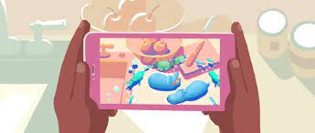


Requirement Specification:
HARDWARE REQUIREMENTS
Cardboard
Magnifier glass or
Google cardboard lens or
Convex lens
SOFTWARE REQUIREMENTS
AR CORE capable android phone.
360 degree video.

Slide 10
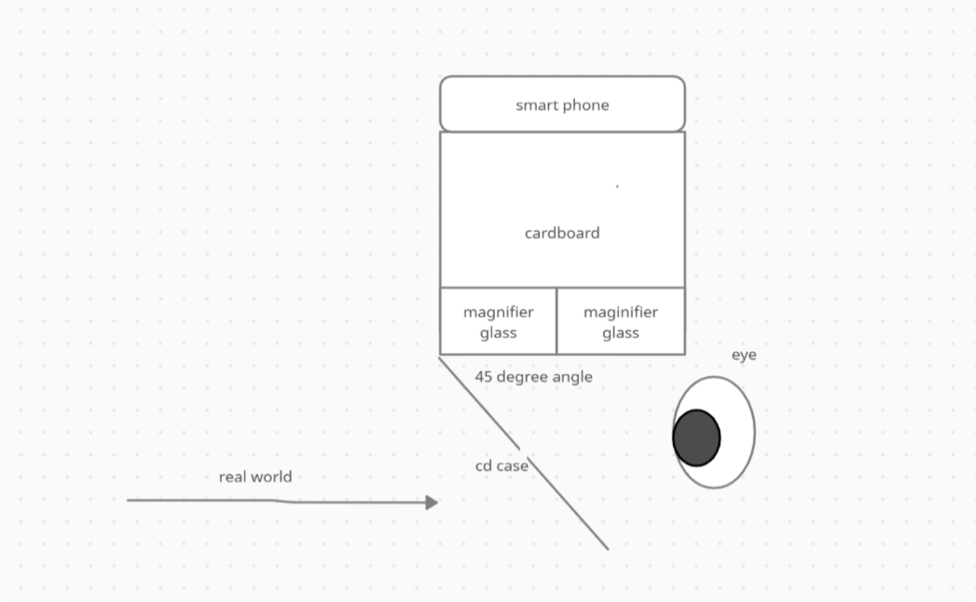
System Design:
BY USING THE LENS AND THE MOBILE THE IMAGE CAN BE VIEWED WITH THE REAL WORLD.

Slide 11
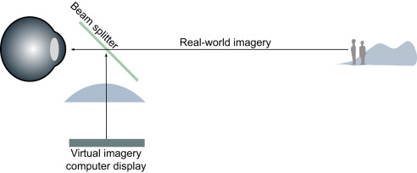
Implementation:
A glass is placed at 45 degree angle, such that we can see through it to the object in front of us. Another source of light is kept perpendicular above the mirror.
The light from this source will partially reflect from the glass surface and beam straight to the observer, who will get a sense that the light is coming from straight ahead.
Thus both objects will appear to be in the same line.

Slide 12
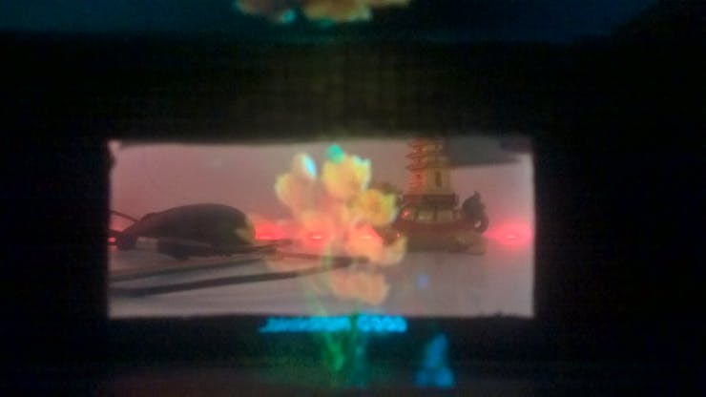
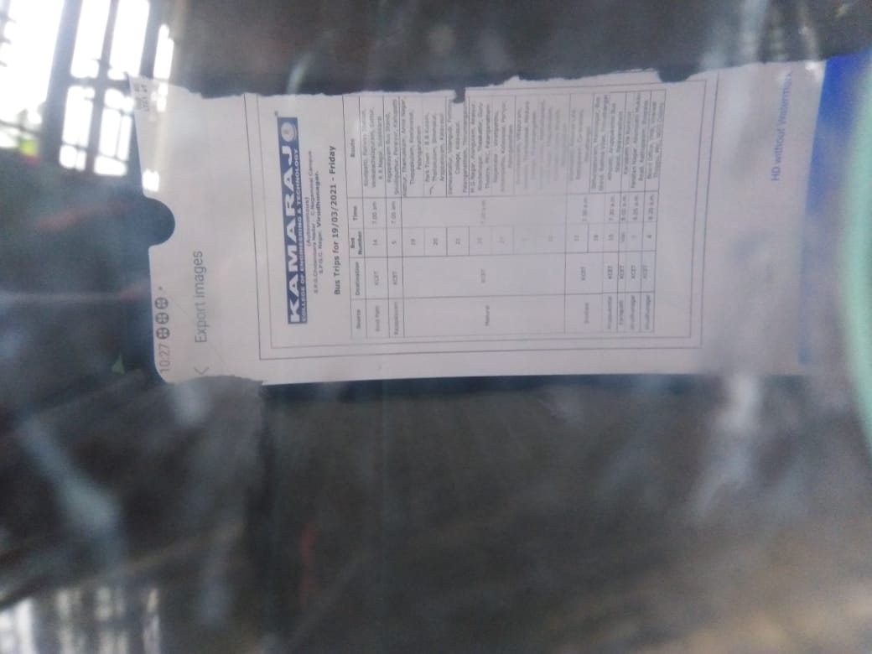
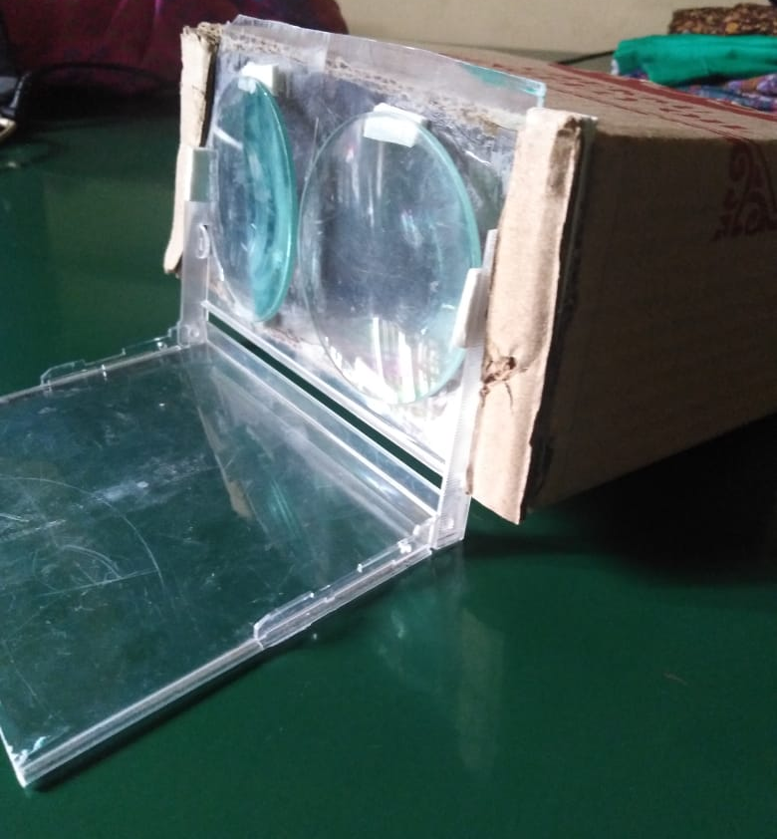
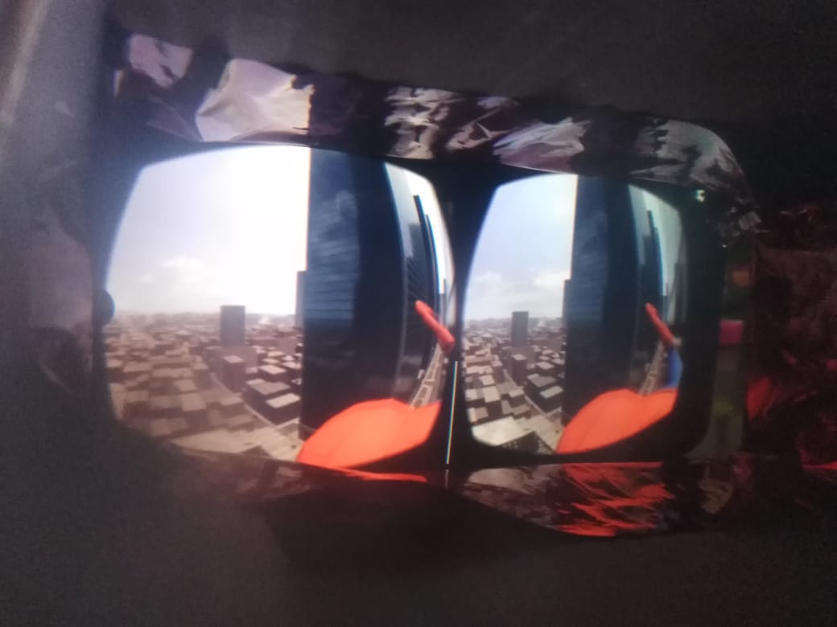
Result:

Slide 13
Social impact:
Wearable AR devices can assist in interactions as well. For example, while delivering a lecture to a classroom and provides basic personal information, such as education or employer, for each member of the meeting, AR can be used.
Not only does this save time, it improves the human interaction. For example, doctors equipped with wearable computers can focus on interacting with and listening to their patients while still having immediate access to patient history in their line of sight.

Slide 14
conclusion:
Despite of the many recent advances in AR, much work remains to be done. Application developments can be helped by using the available libraries.
One of them is AR Toolkit that provides computer vision techniques to calculate a camera’s position and orientation relative to marked cards so that virtual 3D objects can be overlaid precisely on the markers.
This project proposed a simple, less expensive AR viewer, to be useful for learning purposes in Educational Sector. This model would be of more useful to students in Rural areas.

Slide 15
References:
K. Ahlers and A. Kramer. Distribute augmented reality for collaborative design applications. European Computer Industry Research Center, 3-14, 1995.
S. Andrei, D. Chen, C. Tector, A. Brandt, H. Chen, R. Ohbuchi, M. Bajura, and H. Fuchs. Case study: Observing a volume rendered fetus within a pregnant patient. Proceedings of IEEE Visualization, 17-21, 1993.
R. Azuma. Tracking requirements for augmented reality. Communications of the ACM, 36(7):50-51, 1993.
R. Azuma. A survey of augmented reality. ACM SIGGRAPH, 1-38, 1997.
M. Billinghurst, S. Baldis, E. Miller, and S. Weghorst. Shared space: Collaborative information spaces. Proc. of HCI International, 7-10, 1997.

Slide 16
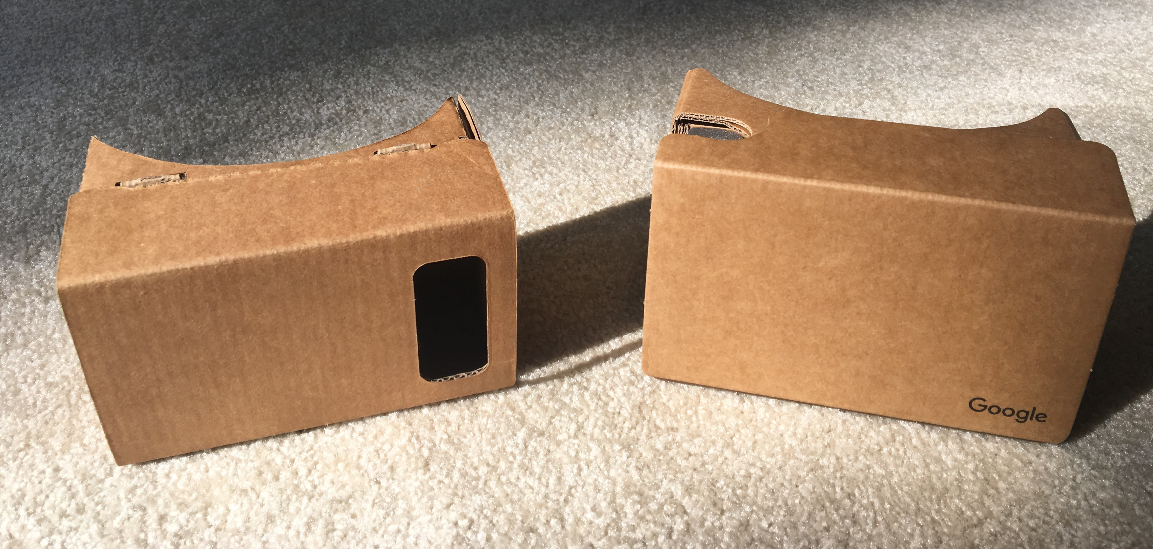
THANK YOU

